Slide 1

SESHADRI RAO GUDLAVALLERU ENGINEERING COLLEGE
DEPARTMENT OF INFORMATION TECHNOLOGY
IOT Project presentation

Slide 2
INTELLIGENT BANK LOCKER
PRESENTED BY : IT_B13
Team members names with Roll numbers:
M . Hema Reddy -1841A1273
D.Sunil – 19485A1217
T.Ravi Teja – 18481A1293
D.Venkatasairam – 19485A1215

Slide 3
CONTENTS:
Introduction
Purpose of project
Motivation and Methodology of Proposed System
Tools required
Block diagram
Advantages & Disadvantages
Applications
Conclusions

Slide 4
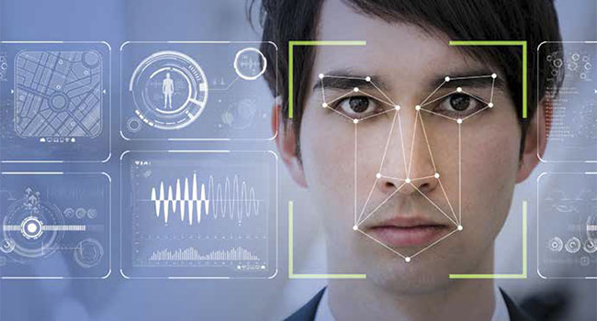
INTRODUCTON:
Banks are considered as a soft targetOf criminals. In this circumstance, ensuring security of bank lockers should Be taken into consideration.
Therefore In this project we propose an IOT based intelligent bank locker and we also introducing face detention approach
IOT
INTELLIGENT BANK LOCKER

Slide 5
PURPOSE OF PROJECT:
As security has become a prime need this concern motivated us to propose such system
The main purpose of the project is safety
This project is mainly IOT based with face detention
Face places a vital role in social intercourse for conveying identity
To put an end to the bank robberies with the help of IOT

Slide 6
MOTIVATION AND METHODOLOGY OF PROPOSED SYSTEM :
This research is mainly based on IOT. Many researcher have developed, implement or proposed different system to ensure the security of bank locker as security has become a prime need this concern motivated us to proposed such system so in order to ensure security of individuals we can use this system. The whole system is designed to implement through internet server

Slide 7
TOOLS REQUIRED:
IBM CLOUD
NODE RED SERVICE
PYTHON IDLE (with Specified Packages installed).

Slide 8
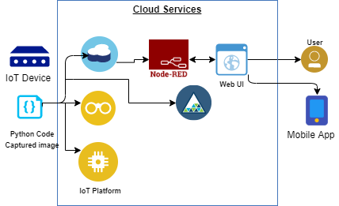
BLOCK DIAGRAM

Slide 9
ADVANTAGES:
High security
Detailed information will provided by the system after detecting the face for confirmation
Without taking any help we can access our locker
It is more accurate as the machine do the process
Paper work will decrease by this system

Slide 10
DISADVANTAGES:
As the whole process based on IOT platform there may be some decrease in employment
May fails when detects similar faces
Accessing this system may be difficult for new users
As it is IOT based own phone or pc required for accessing this application
Updating of face is required as our face changes by age

Slide 11
APPLICATIONS :
This project can also be useful in industrial sector
This project can be used in lockers given for students in their schools/colleges for protecting their belongings

Slide 12
APPLICATIONS:
MOBILE APPLICATION
WEB APPLICATION

Slide 13
CONCLUSION:
we have proposed an IOT based smart locker to ensure the security of valuables.
This system has face detection approach that will count the number of user’s present in front of the locker at any particular time
This smart locker is much better than traditional locker because it does not require any traditional key to unlock the locker
It is highly reliable system to ensure the security of our valuables

Slide 14
REFERENCE :
https://www.researchgate.net/publication/333085904_Smart_Locker_IOT_based_Intelligent_Locker_with_Password_Protection_and_Face_Detection_Approach

Slide 15


